Slide 1
Camera Calibration class 9
Multiple View Geometry
Comp 290-089
Marc Pollefeys

Slide 2
Content
Background: Projective geometry (2D, 3D), Parameter estimation, Algorithm evaluation.
Single View: Camera model, Calibration, Single View Geometry.
Two Views: Epipolar Geometry, 3D reconstruction, Computing F, Computing structure, Plane and homographies.
Three Views: Trifocal Tensor, Computing T.
More Views: N-Linearities, Multiple view reconstruction, Bundle adjustment, auto-calibration, Dynamic SfM, Cheirality, Duality

Slide 3
Multiple View Geometry course schedule
(subject to change)
Jan. 7, 9 | Intro & motivation | Projective 2D Geometry
Jan. 14, 16 | (no class) | Projective 2D Geometry
Jan. 21, 23 | Projective 3D Geometry | (no class)
Jan. 28, 30 | Parameter Estimation | Parameter Estimation
Feb. 4, 6 | Algorithm Evaluation | Camera Models
Feb. 11, 13 | Camera Calibration | Single View Geometry
Feb. 18, 20 | Epipolar Geometry | 3D reconstruction
Feb. 25, 27 | Fund. Matrix Comp. | Structure Comp.
Mar. 4, 6 | Planes & Homographies | Trifocal Tensor
Mar. 18, 20 | Three View Reconstruction | Multiple View Geometry
Mar. 25, 27 | MultipleView Reconstruction | Bundle adjustment
Apr. 1, 3 | Auto-Calibration | Papers
Apr. 8, 10 | Dynamic SfM | Papers
Apr. 15, 17 | Cheirality | Papers
Apr. 22, 24 | Duality | Project Demos

Slide 4
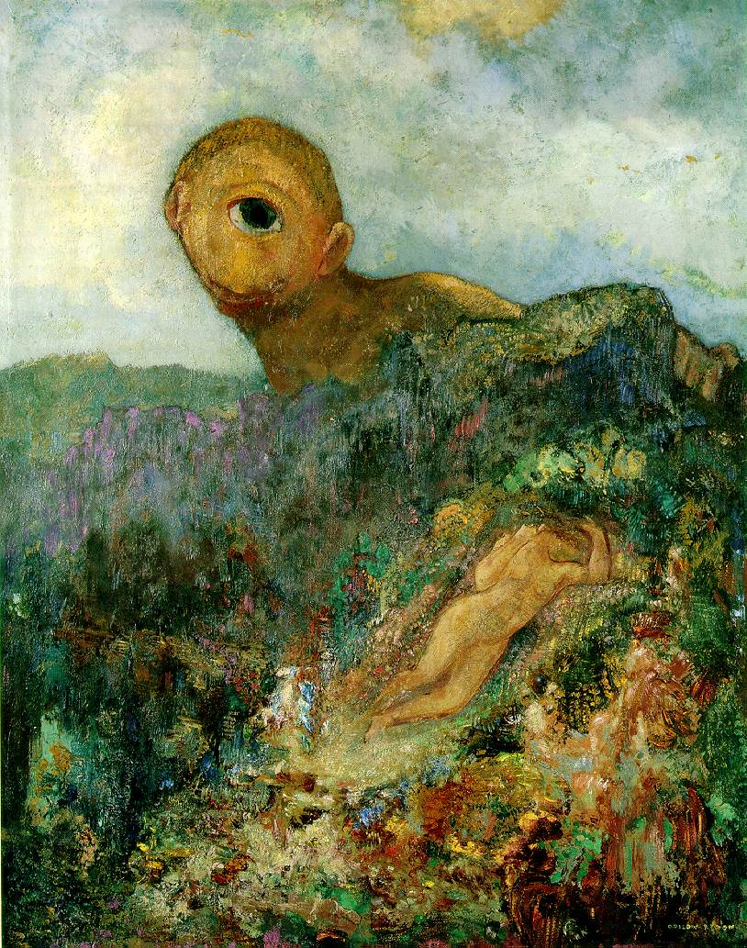
Single view geometry
Camera model
Camera calibration
Single view geom.

Slide 5
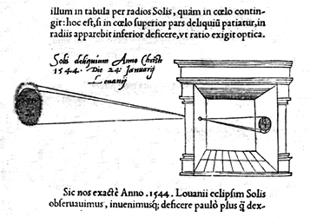
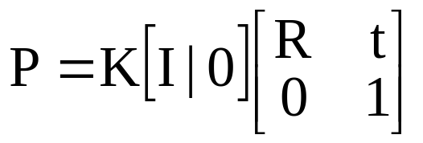

Pinhole camera

Slide 6
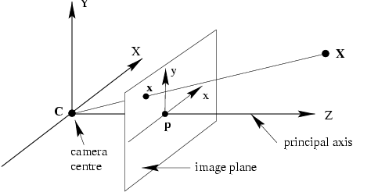
Camera anatomy
Camera center
Column points
Principal plane
Axis plane
Principal point
Principal ray

Slide 7
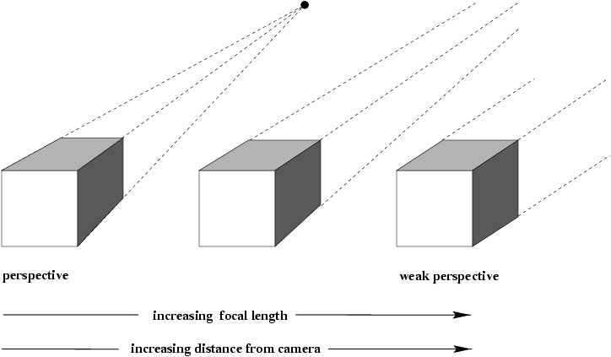
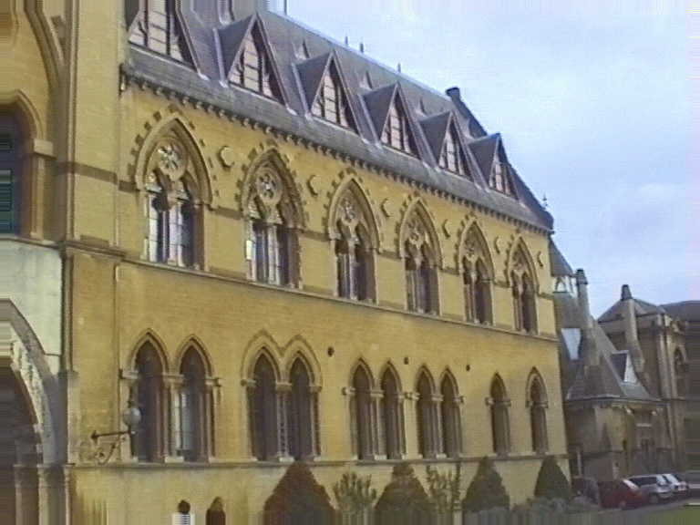
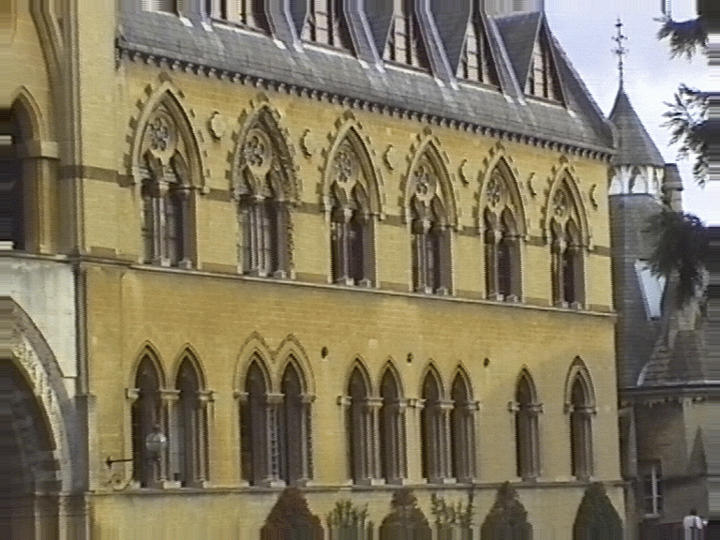
Affine cameras

Slide 8
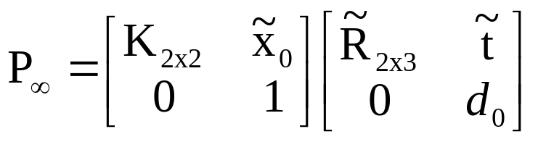
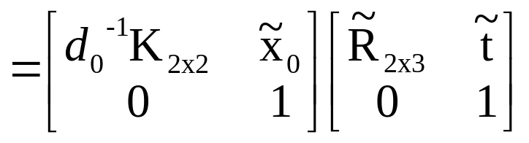
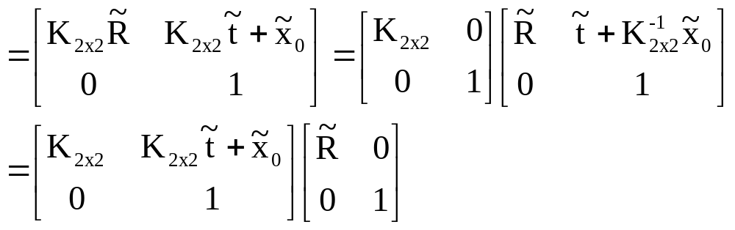
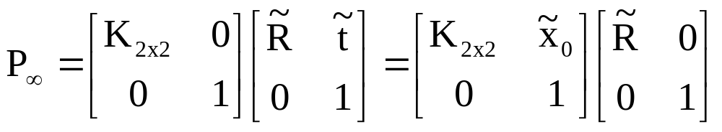
Decomposition of P∞
absorb d₀ in K_{2x2}
alternatives, because 8dof (3+3+2), not more

Slide 9
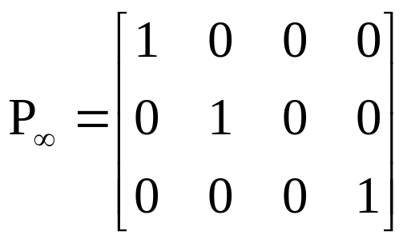
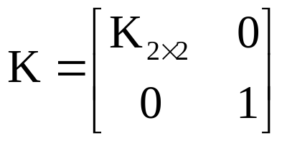
Summary parallel projection
canonical representation
calibration matrix
principal point is not defined

Slide 10
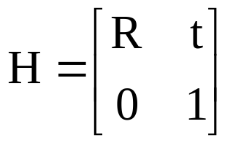
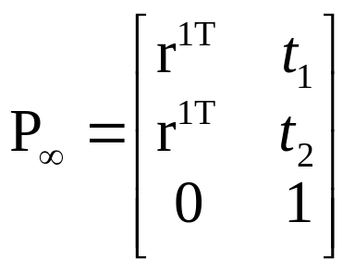
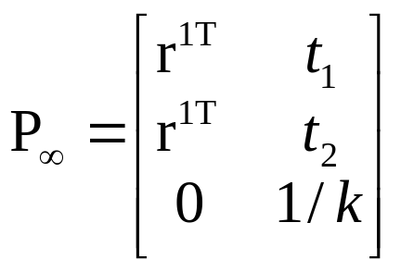
A hierarchy of affine cameras
Orthographic projection
(5dof)
Scaled orthographic projection
(6dof)

Slide 11
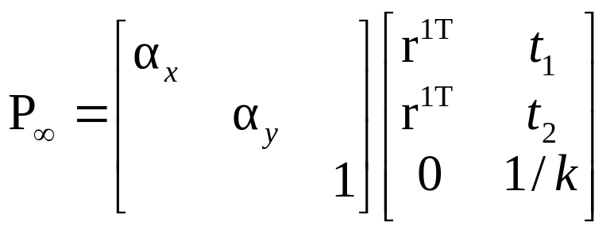
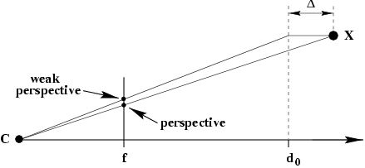
A hierarchy of affine cameras
Weak perspective projection
(7dof)

Slide 12
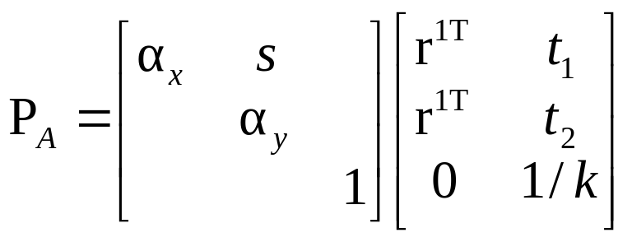
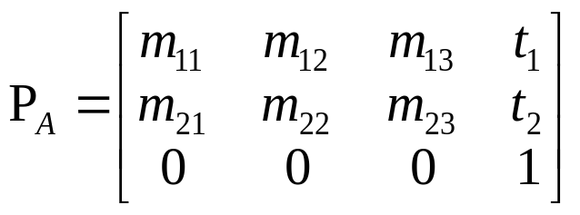
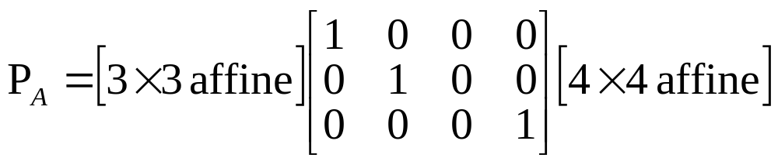
A hierarchy of affine cameras
Affine camera
(8dof)
Affine camera=camera with principal plane coinciding with Π∞
Affine camera maps parallel lines to parallel lines
No center of projection, but direction of projection P_{A}D=0
(point on Π∞)

Slide 13
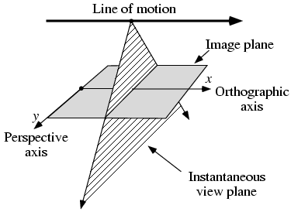



Pushbroom cameras
(11dof)
Straight lines are not mapped to straight lines!
(otherwise it would be a projective camera)

Slide 14
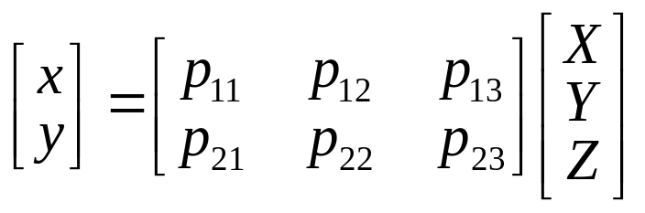

Line cameras
(5dof)
Null-space PC=0 yields camera center
Also decomposition

Slide 15
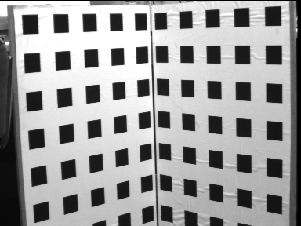
Camera calibration

Slide 16


Resectioning

Slide 17


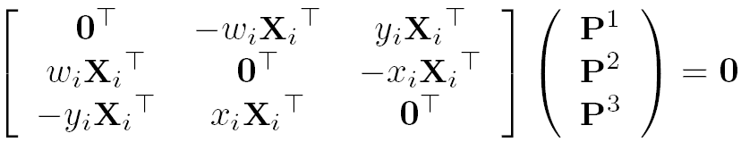
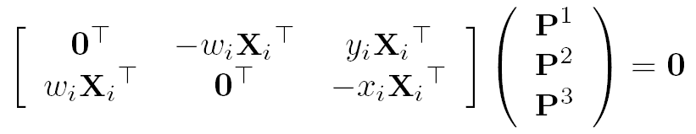

Basic equations

Slide 18

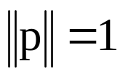
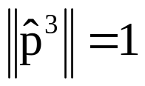


Basic equations
minimal solution
P has 11 dof, 2 independent eq./points
5½ correspondences needed (say 6)
Over-determined solution
n ≥ 6 points
minimize subject to constraint

Slide 19
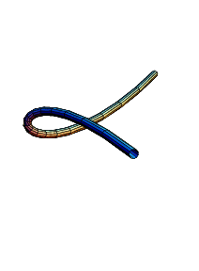
Degenerate configurations
More complicate than 2D case (see Ch.21)
  Camera and points on a twisted cubic
  Points lie on plane or single line passing
  through projection center

Slide 20


Data normalization
Less obvious
(i) Simple, as before
(ii) Anisotropic scaling

Slide 21
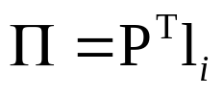
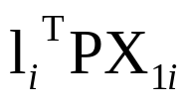
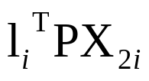
Line correspondences
Extend DLT to lines
(back-project line)
(2 independent eq.)

Slide 22
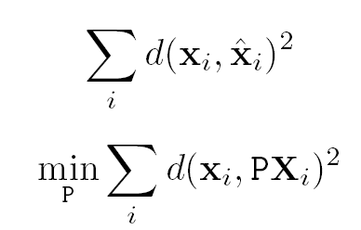
Geometric error

Slide 23


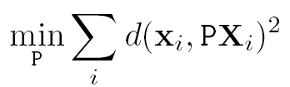

Gold Standard algorithm
Objective
Given n≥6 2D to 2D point correspondences {X_{i}↔x_{i}’}, determine the Maximum Likelyhood Estimation of P
Algorithm
Linear solution:
  Normalization:
  DLT:
Minimization of geometric error: using the linear estimate as a starting point minimize the geometric error:
Denormalization:
~
~
~

Slide 24
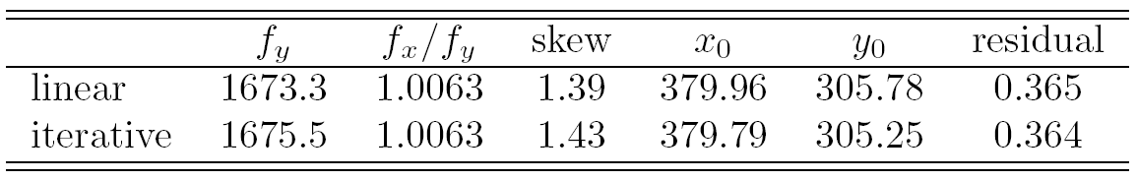
Calibration example
Canny edge detection
Straight line fitting to the detected edges
Intersecting the lines to obtain the images corners
typically precision <1/10
(HZ rule of thumb: 5n constraints for n unknowns

Slide 25
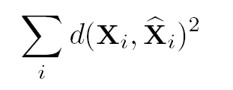
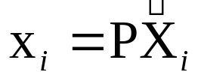
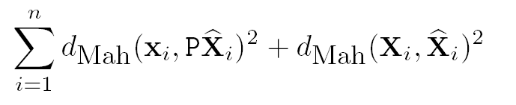

Errors in the world
Errors in the image and in the world

Slide 26
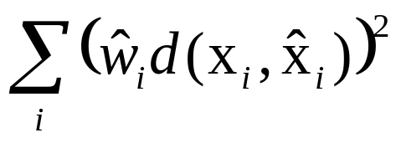
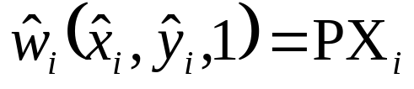
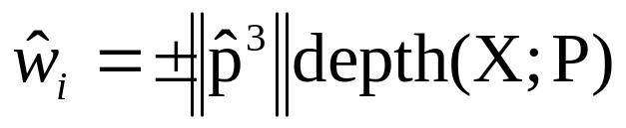
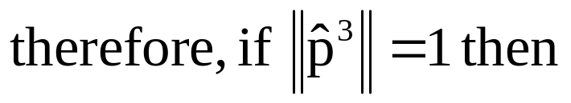
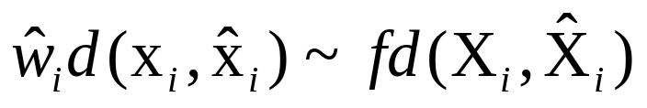
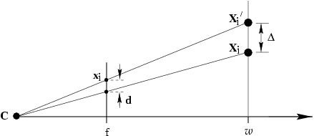
Geometric interpretation
of algebraic error
note invariance to 2D and 3D similarities
given proper normalization

Slide 27
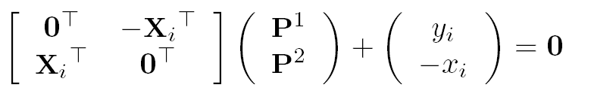
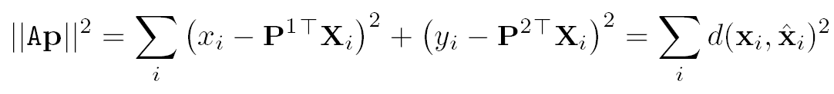
Estimation of affine camera
note that in this case algebraic error = geometric error

Slide 28

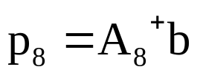
Gold Standard algorithm
Objective
Given n≥4 2D to 2D point correspondences {X_{i}↔x_{i}’}, determine the Maximum Likelyhood Estimation of P
(remember P^{3T}=(0,0,0,1))
Algorithm
Normalization:
For each correspondence
solution is
Denormalization:

Slide 29
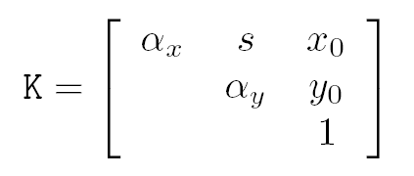
Restricted camera estimation
Find best fit that satisfies
skew s is zero
pixels are square
principal point is known
complete camera matrix K is known
Minimize geometric error
impose constraint through parametrization
Image only ⁹ → ^{2n}, otherwise ^{3n+9} → ^{5n}
Minimize algebraic error
assume map from param q → P=K[R|-RC], i.e. p=g(q)
minimize ||Ag(q)||

Slide 30

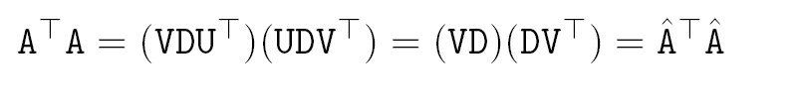
Reduced measurement matrix
One only has to work with 12x12 matrix, not 2nx12

Slide 31
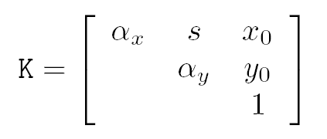

Restricted camera estimation
Initialization
Use general DLT
Clamp values to desired values, e.g. s=0, α_{x}= α_{y}
Note: can sometimes cause big jump in error
Alternative initialization
Use general DLT
Impose soft constraints
gradually increase weights

Slide 32
Exterior orientation
Calibrated camera, position and orientation unkown
→ Pose estimation
6 dof ⇒ 3 points minimal (4 solutions in general)

Slide 33


Slide 34


Covariance estimation
ML residual error
Example: n=197, =0.365, =0.37

Slide 35





Covariance for estimated camera
Compute Jacobian at ML solution, then
(variance per parameter can be found on diagonal)
cumulative⁻¹
(chi-square distribution
=distribution of sum of squares)

Slide 36







Slide 37



Radial distortion
short and long focal length

Slide 38



Slide 39



Slide 40


Correction of distortion
Choice of the distortion function and center
Computing the parameters of the distortion function
Minimize with additional unknowns
Straighten lines
…

Slide 41






Next class:
More Single-View Geometry
Projective cameras and
planes, lines, conics and quadrics.
Camera calibration and vanishing points, calibrating conic and the IAC

